Slide 1

A Brief Introduction to SDN
V0.1

Slide 2
Outline
What is and why SDN?
Notes:
At a high level, abstraction is to hide issues that others do not want to or hard to do things.

Slide 3
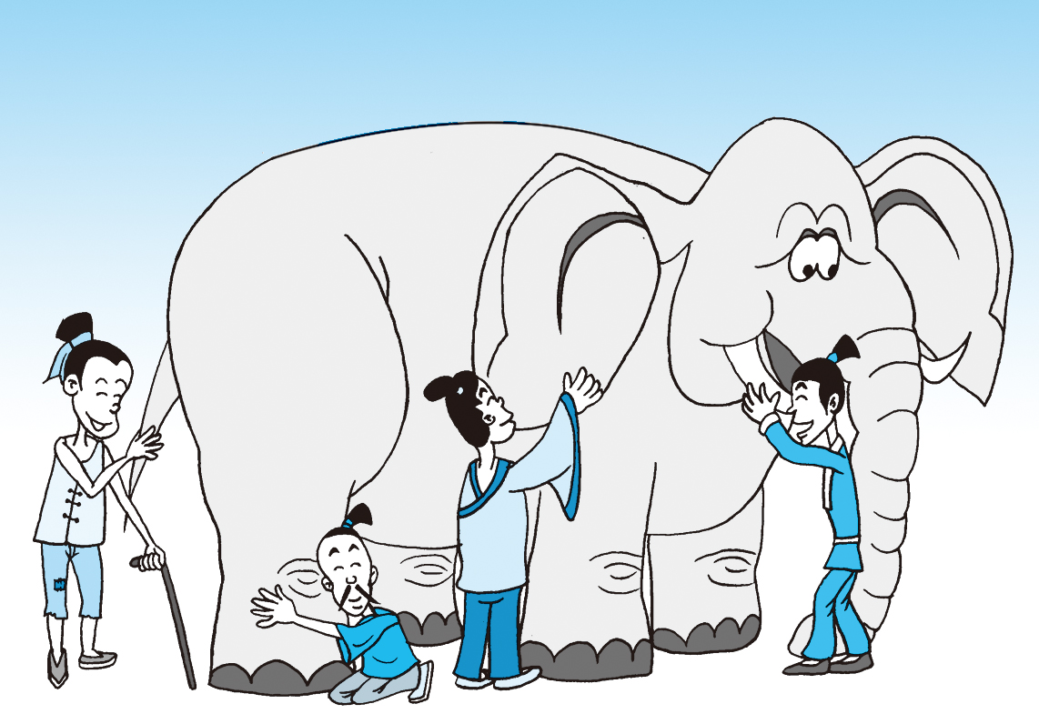
What is SDN?
Notes:
At a high level, abstraction is to hide issues that others do not want to or hard to do things.

Slide 4
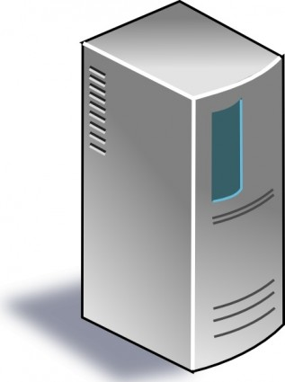
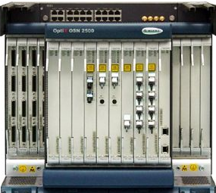
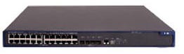
What is SDN: a “Main-Stream” View
Separation of data and control paths, with a logically centralized control plan
Traditional
SDN
Control
Control
standard control
protocol
Datapath
Datapath
Control
Datapath
Datapath
Control
Datapath
Datapath
Notes:
FLP, Arrow’s Impossibility Theorem. Failure of distributed computing.

Slide 5
An Evolution View of Intradomain Routing Toward SDN
Distance Vector
Link State
Dijkstra
Distributed Bellman Ford
Distributed Link State
Datapath
Datapath
Dijkstra
Distributed Bellman Ford
Distributed Link State
Datapath
Datapath
Dijktra
Distributed Bellman Ford
Distributed Link State
Datapath
Datapath
Notes:
FLP, Arrow’s Impossibility Theorem. Failure of distributed computing.

Slide 6
An Evolution View of Intradomain Routing Toward SDN
Link State
SDN
Control
Dijkstra
Link State
Distributed Link State
standard control
protocol
Datapath
Datapath
Dijkstra
Distributed Link State
Datapath
Datapath
Dijkstra
Distributed Link State
Datapath
Datapath
Notes:
FLP, Arrow’s Impossibility Theorem. Failure of distributed computing.

Slide 7
Why SDN (A “Defeatist” View)?
Distributed computing is hard, e.g.,
FLP Impossibility Theorem
Arrow’s Impossibility Theorem
Achieved good design for only some specific tasks (e.g., state distribution, leader election). Hence, one can consider SDN as a way of moving away from generic distributed computing, by focusing on utilizing the few well-understood primitives, in particular centralized state.

Slide 8
What is SDN: a “Whitebox”/Programmable-Network View
Separation of switch hardware and software
Traditional
Whitebox
SoftwareB
SoftwareC
HardwareB
HardwareB
SoftwareA
SoftwareC
HardwareA
HardwareA
SoftwareC
SoftwareD
HardwareC
HardwareA
Notes:
FLP, Arrow’s Impossibility Theorem. Failure of distributed computing.

Slide 9
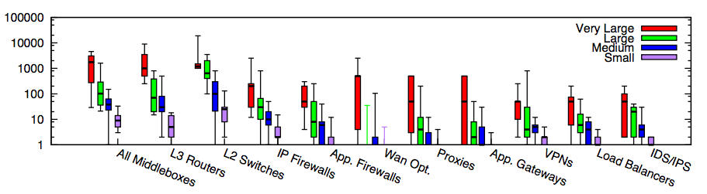
Why SDN or More Programmable Networks?
Modern networks contain increasingly more diverse types of equipment
In traditional settings, each type/vendor runs in its own hardware box
Substantial flexibility if more programmable nets
Small: <=1k hosts; Medium: 1k-10k; Large: 10k-100k; Very Large: >= 100k
Source: [Sherry, et. al SIGCOMM’12]
Notes:
为啥呢？因为total ownership cost少。1. 我server买了，3年合同以后可以自行切换。前三年load cisco的virtual router，后三年load juniper的virtual switch。再过三年load palo alto的virutal firewall 2. 设备performance更新，只需要换低层硬件，就可以扩展
Router, switch, firewall merge
Server + software, which include Router, Switch, FT
DC -> Cloud
ENT switch reducing; Cloud increasing
There are more virtual ports than physical ports, where the virtual ports are controlled by x86 software. Where software erodes hardware

Slide 10
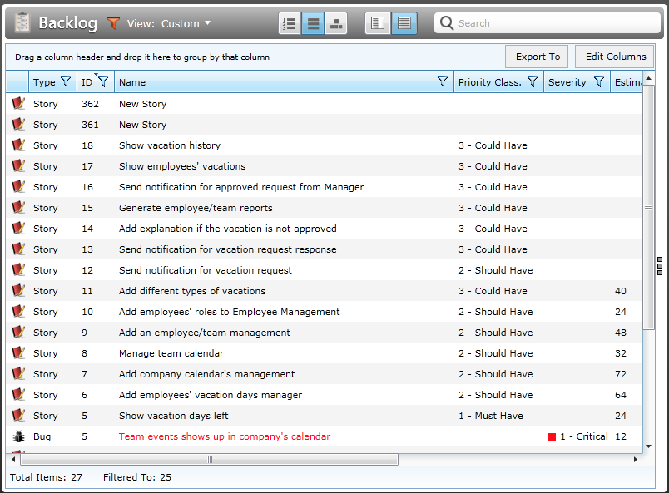
Why SDN or More Programmable Networks?
Network customization/feature requests can be a slow process. Open/programmable systems introduce competition and better allow innovation
Notes:
small (fewer than 1k hosts), medium (1k-10k hosts), large (10k-100k hosts), and
very large (more than 100k hosts) enterprise network

Slide 11

More Programmable Networks are a Well Recognized Trend
“We are focusing on a market transition involving the move toward more programmable, flexible, and virtual networks… This transition is focused on moving from a hardware-centric approach for networking to a virtualized network environment that is designed to enable flexible, application-driven customization of network infrastructures. -- Cisco Annual Report (pp2), Nov. 2015
Notes:
“The cost to operate networks is too high and growing too fast and you can’t find enough people to manage these things anymore. It’s time for change.” -- Nick Lippis, ONUG /Fidelity, 2013
To appeal to companies looking for more highly customized systems, Cisco has also opened up its software to programmers in new ways, making it easier for clients to write their own apps for Cisco products.
http://www.bloomberg.com/news/articles/2015-11-05/cisco-s-new-ceo-embraces-the-cloud

Slide 12
What is SDN: A New Control-Abstraction View
Major advances in many fields of computer science are based on simple, powerful abstractions
“Modularity based on abstraction is the way things get done.” -- Barbara Liskov
A major lacking of networking is that we do not have enough good abstractions in network management and control
Three key areas for abstractions [Shenker’11]: Distribution, configuration, and forwarding
Notes:
Hide details; Provide automatic optimization
Theory: Turing machine; systems: DB/relational algebra; OS/Virtual memory/thread; PL: low level language to higher level languages. Networking layer architecture is abstractions for data plane. Major advance is possible if we introduce the right abstractions in the network control plane.

Slide 13
Outline
What is and why SDN?
SDN now
Notes:
At a high level, abstraction is to hide issues that others do not want to or hard to do things.

Slide 14
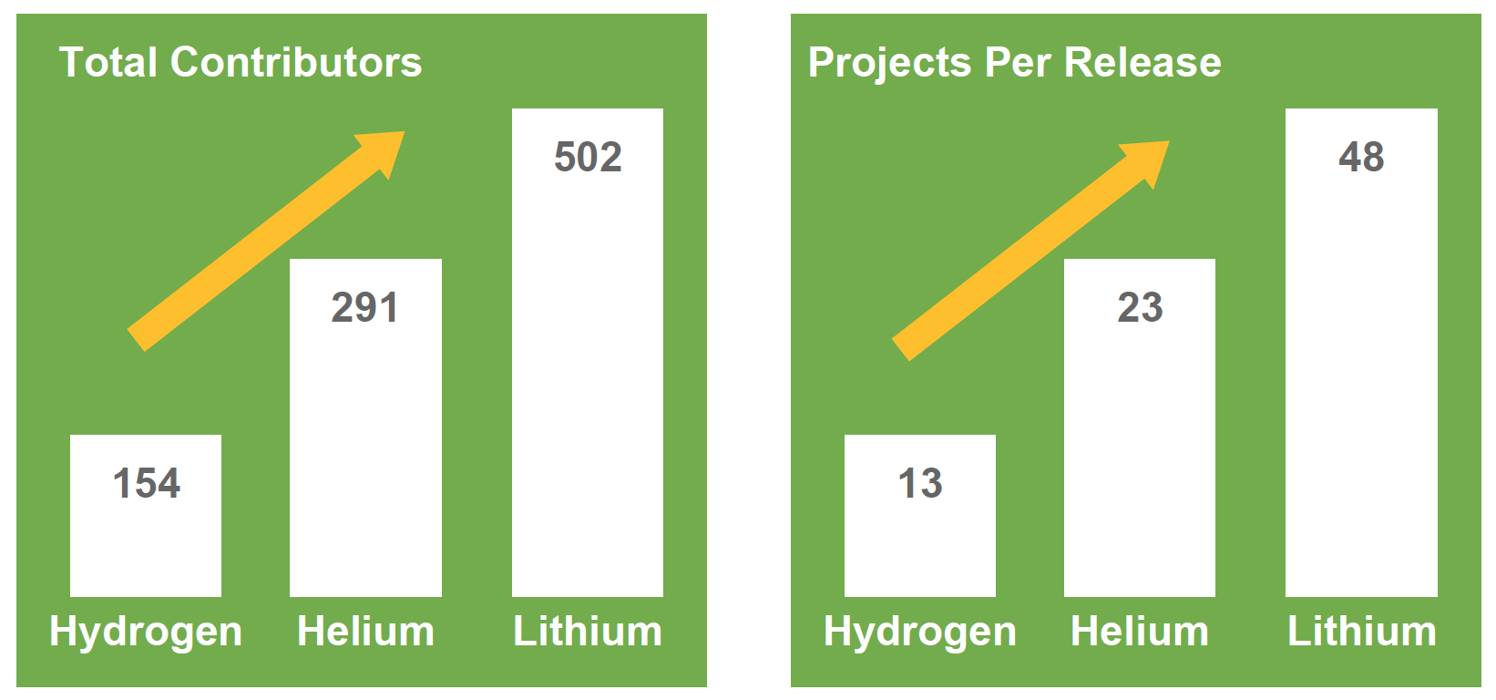
Increasing Interests (ODL as an Example)
Source: Neela Jacques, July 2015.
Notes:
At a high level, abstraction is to hide issues that others do not want to or hard to do things.

Slide 15
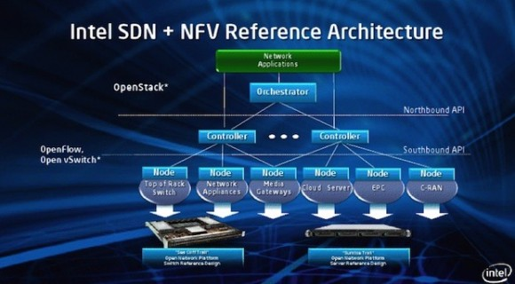
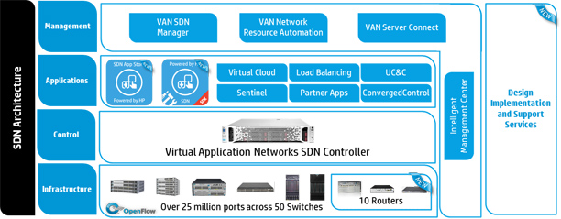
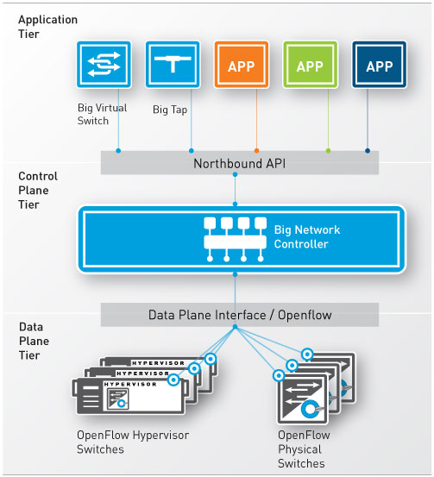
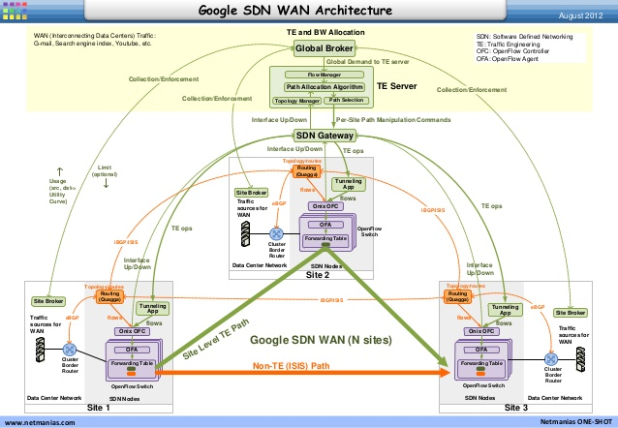
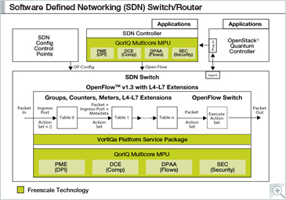
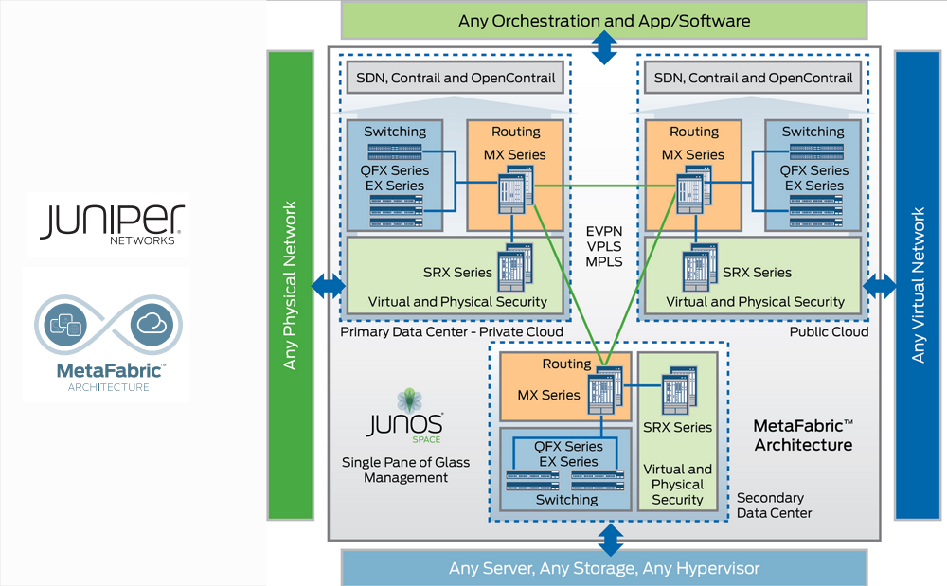
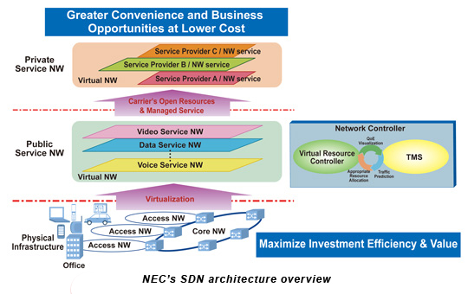
Almost Every Network Vendor has an SDN Architecture
http://h17007.www1.hp.com/images/networking/solutions/technology/sdn/sdn-architecture.jpg
Notes:
At a high level, abstraction is to hide issues that others do not want to or hard to do things.

Slide 16
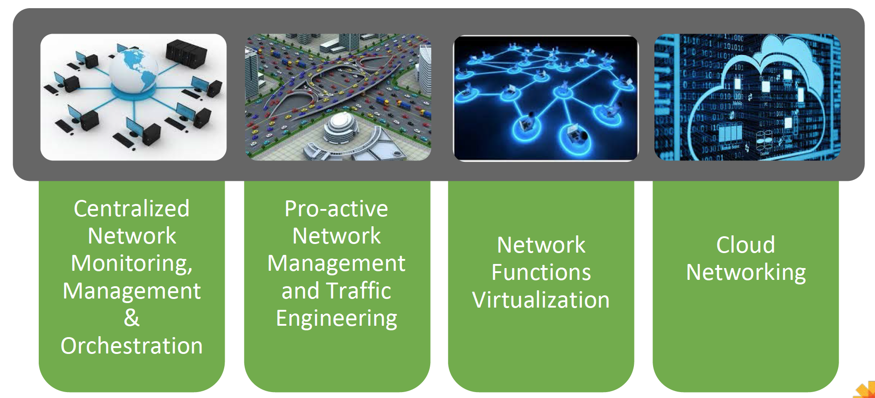
Some Main Current Use Cases of SDN
Source: Neela Jacques, July 2015.
Notes:
At a high level, abstraction is to hide issues that others do not want to or hard to do things.

Slide 17
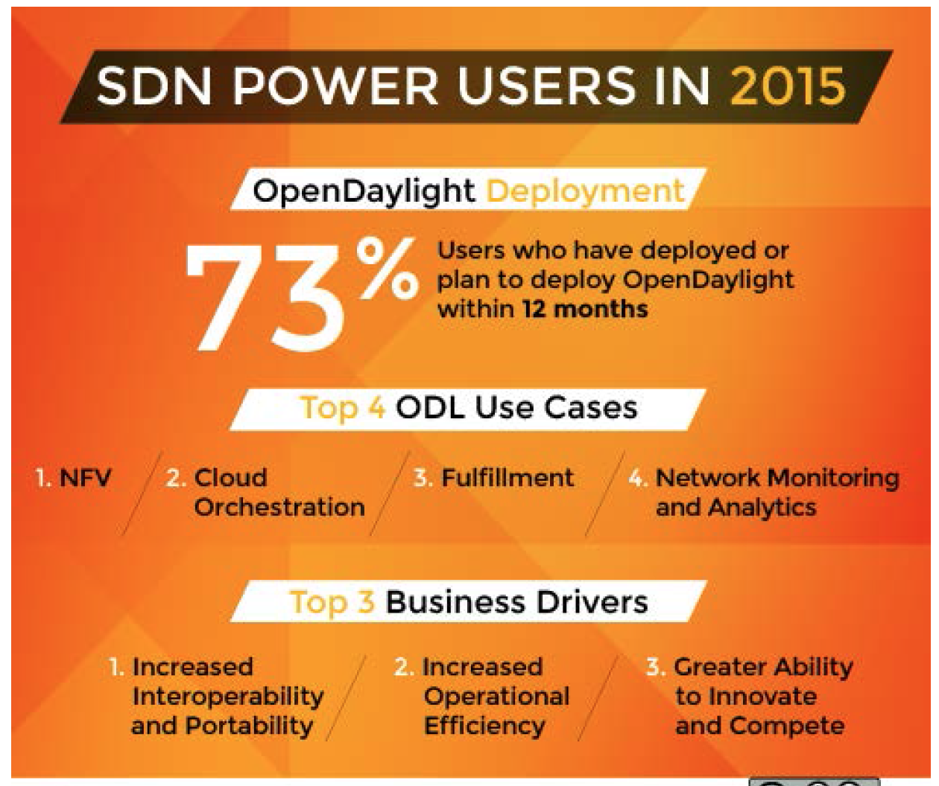
Results of a User Survey
128 Companies responded
31% Telcos/Service Providers
24% Research/Academia
20% Enterprises
10% Services/Consulting
9% Software/Hardware
6% Other
Source: Neela Jacques, July 2015.
Notes:
At a high level, abstraction is to hide issues that others do not want to or hard to do things.

Slide 18
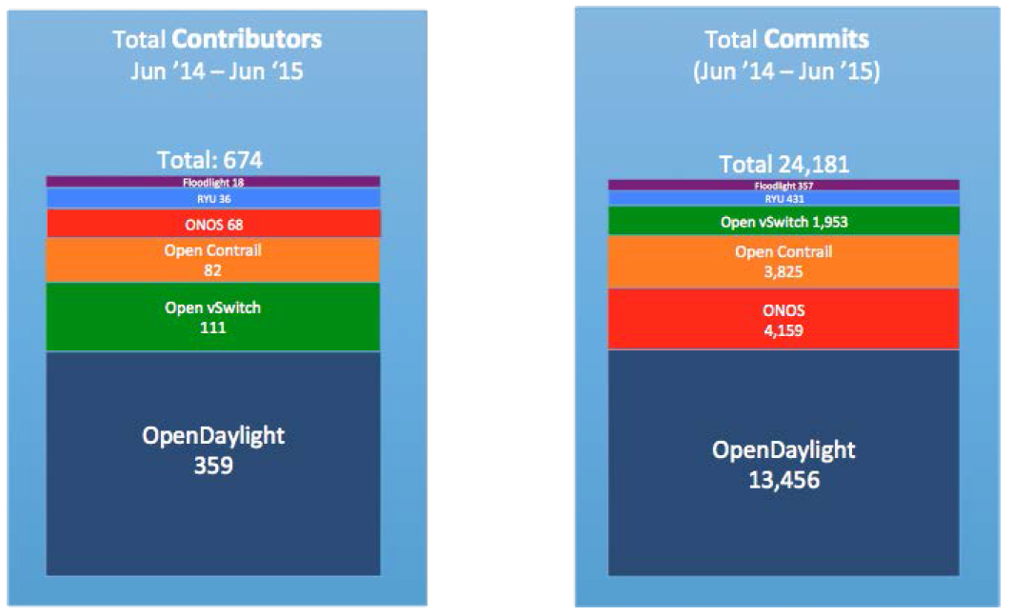
State of Current (Open Source) Players
Source: Neela Jacques, July 2015.

Slide 19
Outline
What is and why SDN?
SDN now
SDN key technical components
Architecture
Notes:
At a high level, abstraction is to hide issues that others do not want to or hard to do things.

Slide 20
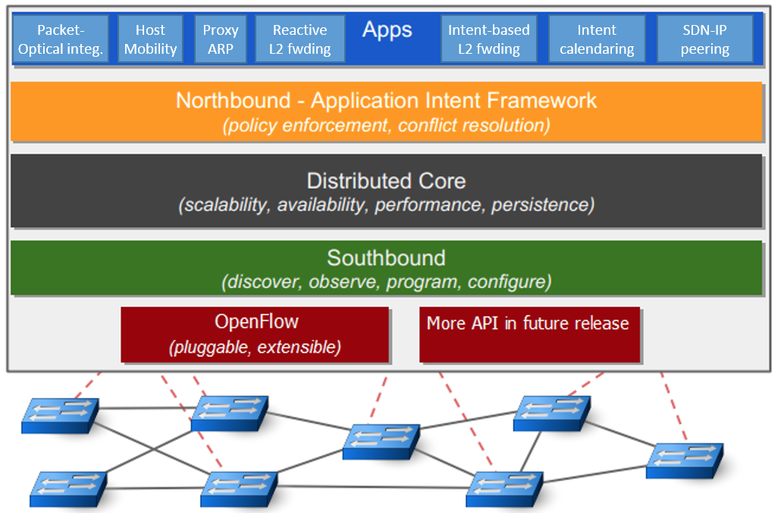
ONOS Architecture: Big Picture
Source: ON.LAB
Notes:
http://api.onosproject.org/1.1.0/org/onosproject/store/Store.html DeviceStore, HostStore, LinkStore, TopologyStore collect info from below
FlowRuleStore supports forwarding abstractions
IntentStore

Slide 21
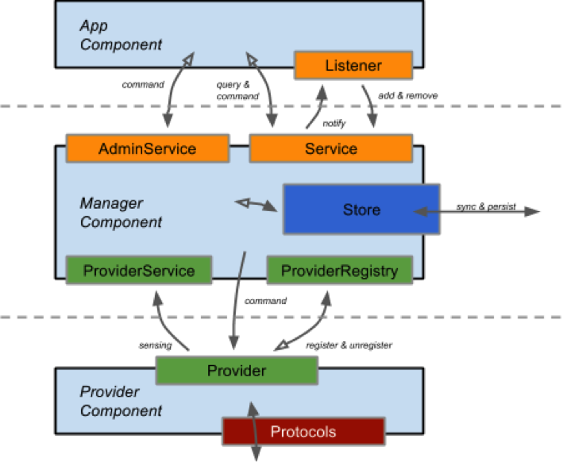
ONOS Architecture: Some Key Abstractions
https://wiki.onosproject.org/display/ONOS/System+Components
Notes:
http://api.onosproject.org/1.1.0/org/onosproject/store/Store.html DeviceStore, HostStore, LinkStore, TopologyStore collect info from below
FlowRuleStore supports forwarding abstractions
IntentStore

Slide 22
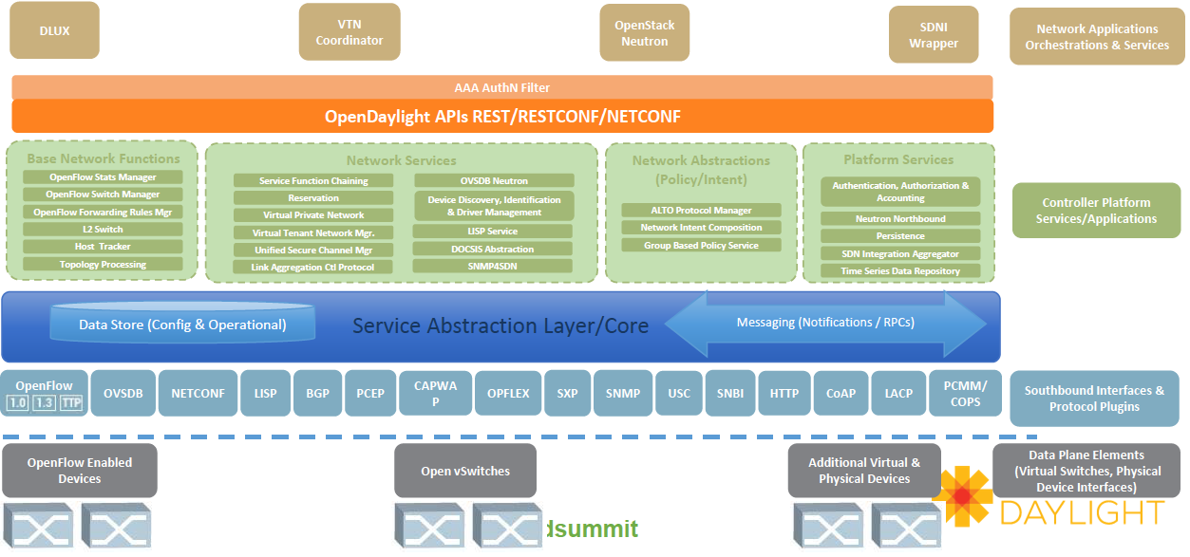
OpenDaylight Architecture: Big Picture
Source: Neela Jacques, July 2015.
Notes:
http://www.bigdatalandscape.com/

Slide 23
OpenDaylight: Some Key Abstractions
Network Devices
Applications
Network Applications Orchestration & Services
Network Devices
Applications
Network Devices
Applications
Controller
NETCONF SERVER
Protocol Plugin
...
Protocol Plugin
App/Service Plugin
...
App/Service Plugin
RESTCONF
Plugins & Applications
Config Subsystem
Model-Driven SAL (MD-SAL)
Controller Platform
Messaging
Data Store
Clustering
Remote Controller Instance
Remote Controller Instance
Source: Ed Warnicke, July 27, 2015.
23

Slide 24
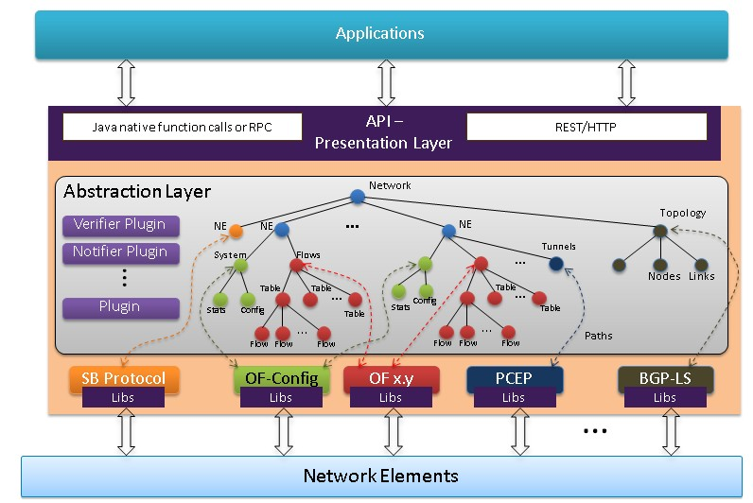
OpenDaylight: YANG Data Store
https://wiki.opendaylight.org/view/OpenDaylight_Controller:Architectural_Framework

Slide 25
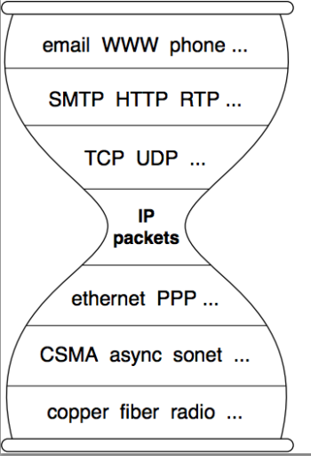
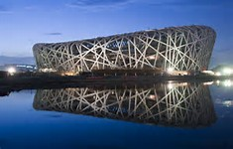
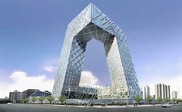
Questions to Keep in Mind on Architecture
- Q-arch1: What are the commonality and differences among the SDN architectures?
- Q-arch2: Is it possible that there can be a reference architecture?
Notes:
topology

Slide 26
Outline
What is and why SDN?
SDN now
SDN key technical components
Architecture
Datapath
Notes:
At a high level, abstraction is to hide issues that others do not want to or hard to do things.

Slide 27
Current SDN Data Path Designs
SDN
Control
OpenFlow
NetConf RestConf
SNMP
Forces
…
Datapath
Datapath
Datapath
OpenFlow1.x OFDPA P4 POP
…
Notes:
FLP, Arrow’s Impossibility Theorem. Failure of distributed computing.

Slide 28

Key Datapath Question
Q-Datapath: What should be the data path of network devices?
Flow tables
VM/Container

Slide 29
Outline
What is and why SDN?
SDN now
SDN key technical components
Architecture
Datapath
Programming abstractions and framework
Notes:
At a high level, abstraction is to hide issues that others do not want to or hard to do things.

Slide 30
Complexity of an SDN Program
Map<MAC, Location> hostTable; List<ACLItem> acls;
Route f(Packet p) {
hostTable.put(p.ethSrc(), p.ingressPort());
if ( !permit(p, acls) ) return drop;
Location src = p.ingressPort();
Location dst = hostTable.get( p.ethDst() );
Route path = myRoutingAlg(topology(), src, dst);
return path;
}
Has states
External process may change the state
Access pkt attributes
External process may change the state
Access state
Access state
Access state
Complex computation
Data path can cause state update

Slide 31
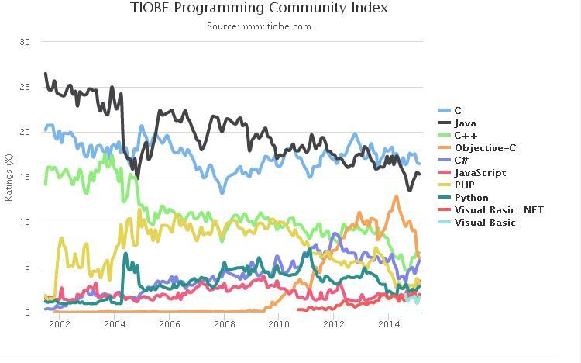
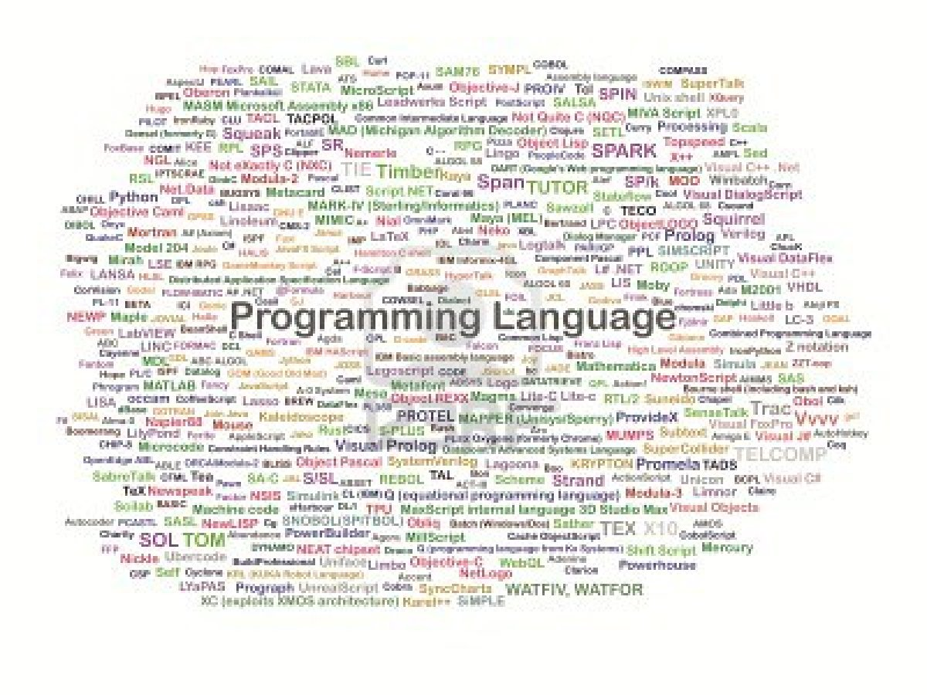
Questions to Keep in Mind on SDN Programming
- Q-prog: What are right programming abstractions and frameworks for SDN?
Source: http://www.freaksense.com/wp-content/uploads/2013/07/10580033-it-a-full-collection-of-programming-language.jpg
Notes:
topology

Slide 32
SDN vs Inherent Complexity
Conjecture: Complexity in highly organized systems arises primarily from design strategies intended to create robustness to uncertainty in their environments and component parts.
Scalability is robustness to changes to the size and complexity of a system as a whole
Evolvability is robustness of lineages to large changes on various (usually long) time scales
Reliability is robustness to component failures
Efficiency is robustness to resource scarcity
Modularity is robustness to component rearrangements
- Q-prog-complexity: Can SDN solve inherent complexity, if the conjecture is correct?
Notes:
At a high level, abstraction is to hide issues that others do not want to or hard to do things.

Slide 33
Outline
What is and why SDN?
SDN now
SDN key technical components
Architecture
Datapath
Programming abstractions and framework
SDN killer apps
Notes:
At a high level, abstraction is to hide issues that others do not want to or hard to do things.

Slide 34
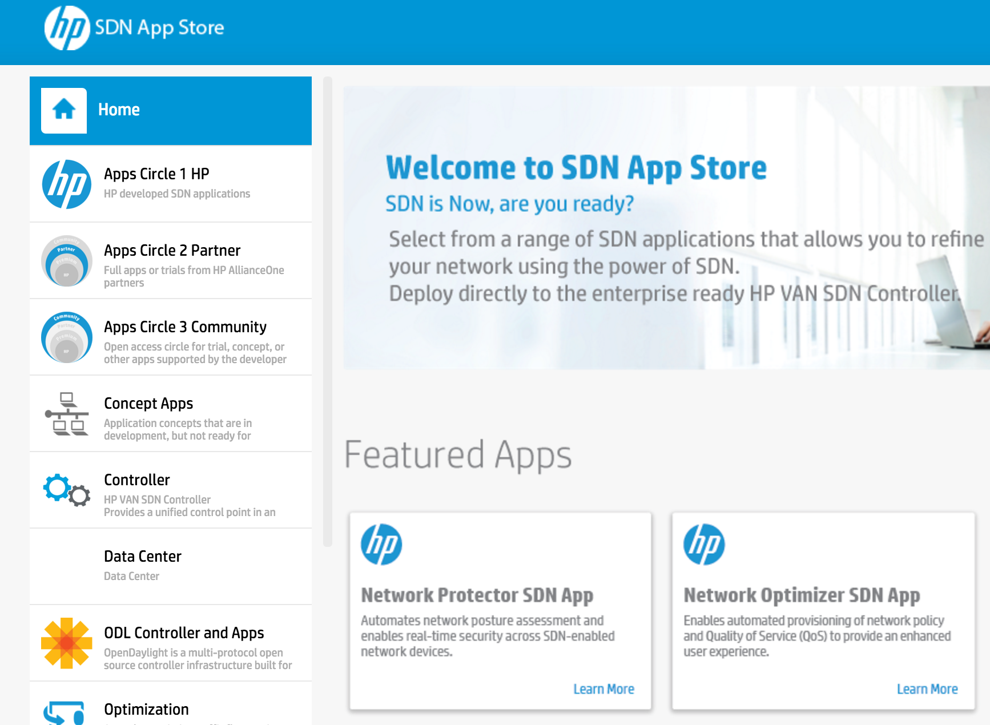

Questions to Keep in Mind on SDN Programming
- Q-app: What are the killer apps of SDN?
Source: http://api.ning.com/files/qgybvJa4VHgEUDHXfN3PUL4Bru*HAQP7gtHz5BUaG6YH*1As0tr9MGh8ewH34GQPpLsxPOh8iYgP3BRLEWSSClN274raRTRX/killer_apps_600x300.jpg
Notes:
topology

Slide 35
Thank you and enjoy the rest of ADL!
Notes:
At a high level, abstraction is to hide issues that others do not want to or hard to do things.

Slide 36
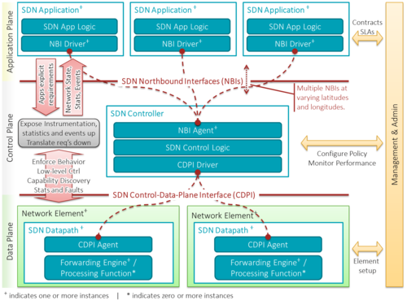
SDN Architecture (Wikipedia)
https://upload.wikimedia.org/wikipedia/commons/thumb/e/e6/SDN-architecture-overview-transparent.png/500px-SDN-architecture-overview-transparent.png
Notes:
topology

